Slide 1
Pandas 5
Merging and Reshaping Data
DSC 270 Data Manipulation

Slide 2
The Plan
Database operations in Pandas you already know
Reshaping: melt, pivot, pivot_table transpose
Concatenating DataFrames
Sorting and reordering rows, indexes, and columns
Merging DataFrames: INNER, LEFT, RIGHT, OUTER JOIN
Insert, Deleting, and Updating columns, rows, and entries

Slide 3
Database operations in Pandas

Slide 4
Recap: Database Operations in Pandas
Select and apply simple computations on columns
df['col1'] + df['col2'] df.loc[:, 'Age':] * 2
Filter rows that meet a condition and limit output
df[df['col2'] > 50].head(5) df.query("Age < 35")
Grouping and aggregation
df.groupby('col3').agg({'col4': ['mean', 'std', rng]})
UP NEXT: merging, reshaping, sorting
merged_df = pd.merge(df1, df2, how='left', on='key')

Slide 5
Reshaping

Slide 6
Reshaping Data in Pandas
Essential for analysis
Rearrange structure without changing data
Functions include melt, pivot, concat, sort

Slide 7
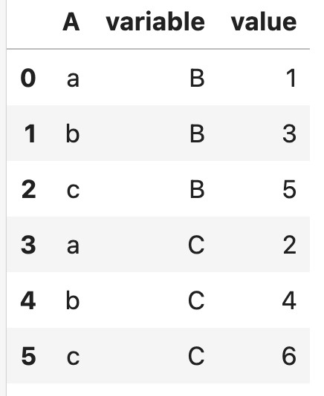
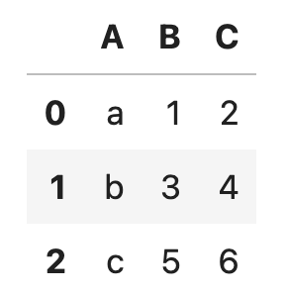
Melt
Transforms wide (pivoted) format to long format
Collapses multiple columns into one
Facilitates stats modeling and data transforms

Slide 8
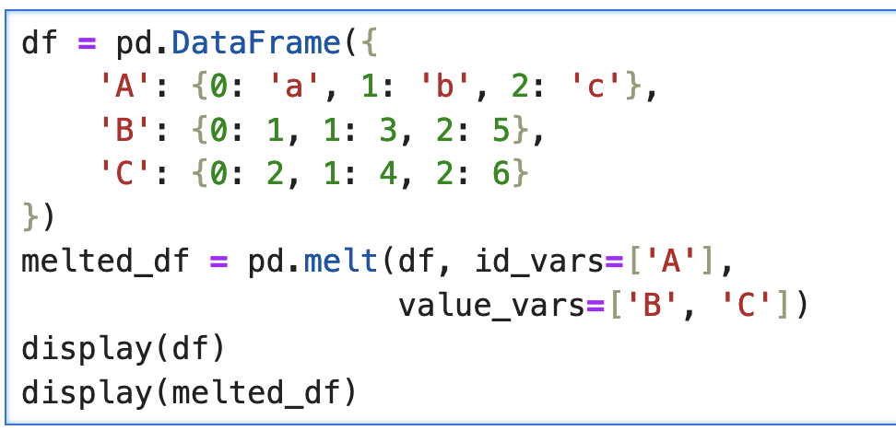

Slide 9
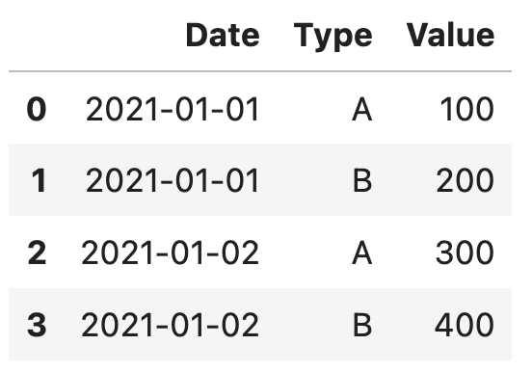
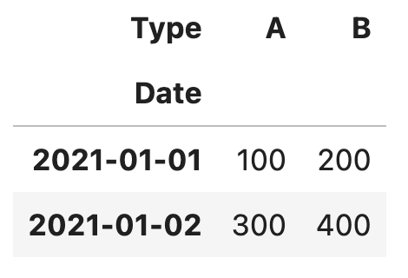
Pivot
Transforms long (melted) format to wide format
Creates new table from group of variables
Enhances data presentation and readability for insights

Slide 10
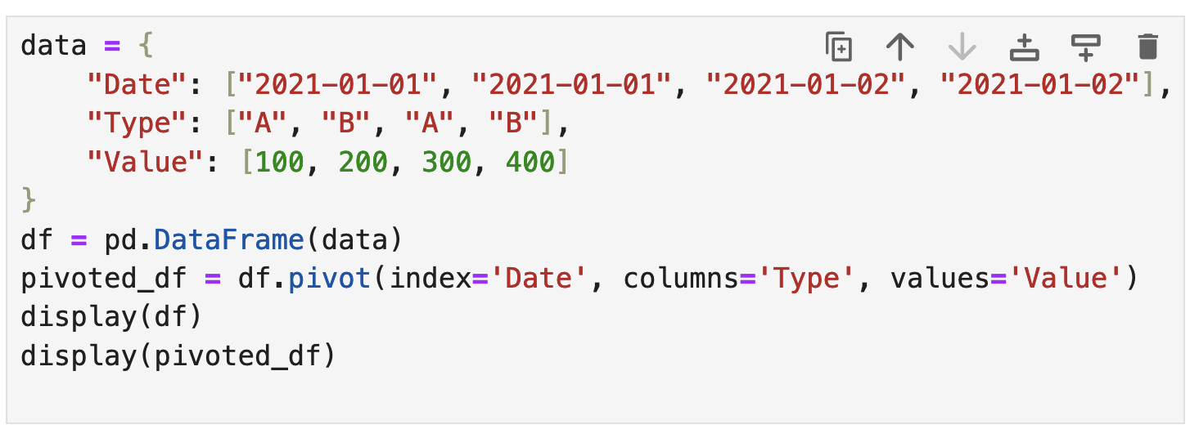

Slide 11
pivot() vs. pivot_table()
pivot(): reshapes data with unique index/column pairs
Doesn't handle aggregation of multiple values itself
Use when you have unique idx/col combinations and want wider format
pivot_table(): Aggregates/reshapes data with duplicate entries
More flexible, can handle duplicate data by aggregating
For reshaping and summarizing data when you have duplicates
Can specify an aggregation function (like mean, sum, count, etc.)
Useful where you need to aggregate data while pivoting

Slide 12
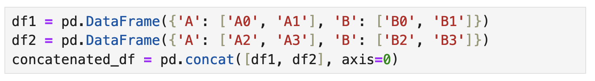
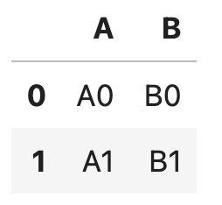
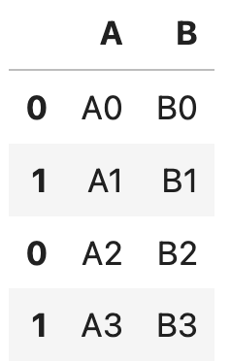
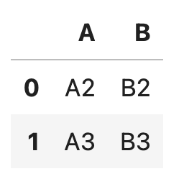
Concatenate DataFrames
Joins multiple DataFrames along rows or columns

Slide 13
Wait! What happened to our index?
Concatenation preserves original indices
May result in duplicates
Can change this with ignore_index=True
This resets the index to create a unique, continuous index

Slide 14
Ordering and Renaming Rows and Columns

Slide 15
Ordering rows
sort_values
Sorts DataFrame on one or more columns lexicographically
Specify ascending=False to sort in descending order
df.sort_values(by='column_name', ascending=True)
sort_index
Sorts DataFrame by index
Useful for organizing data after transformations
df.sort_index(ascending=True)
These return new DataFrames. Reassign or use inplace=True!

Slide 16
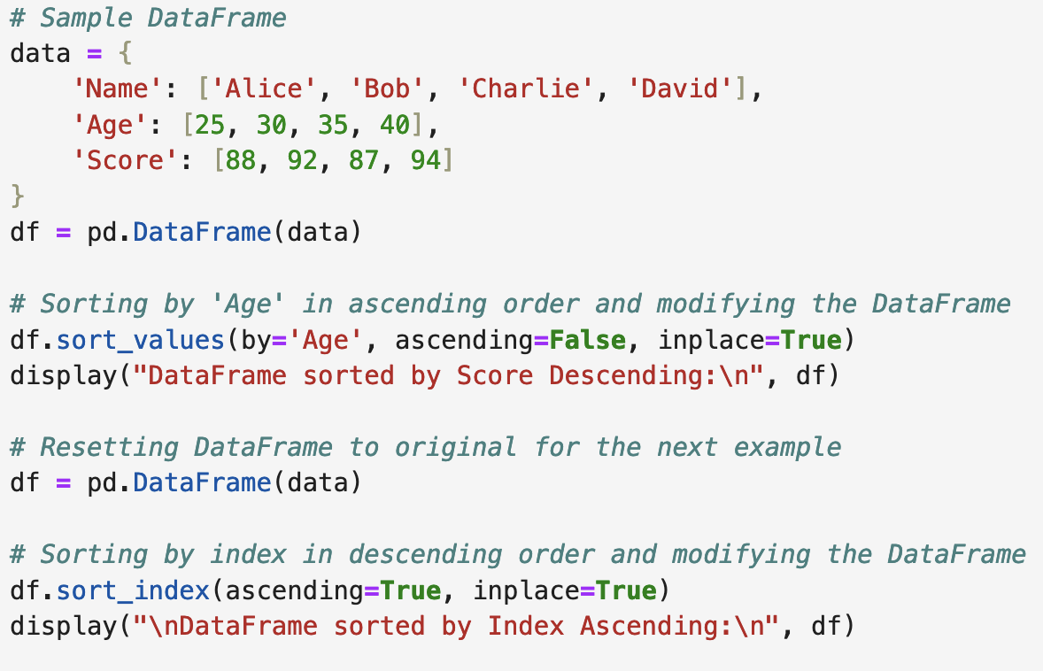
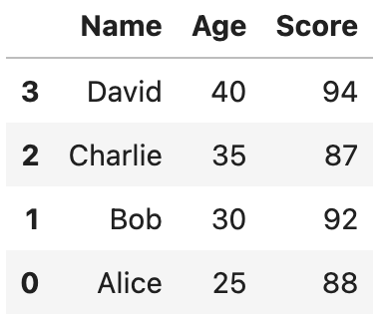
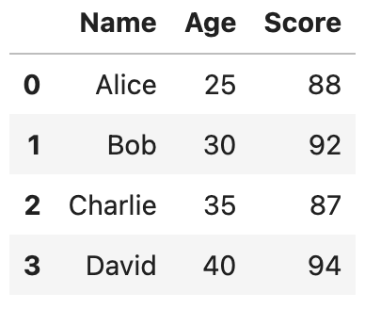

Slide 17
Reset and Drop Indices
reset_index() transform index into column
Create a new sequential index
Use drop=True to avoid adding the old index as a column
Example:
df.reset_index(inplace=True, drop=True)

Slide 18
Reordering Columns in Pandas
Use DataFrame.reindex() to change the order of columns
df = df.reindex(columns=['A', 'B', 'C'])
Alternatively, use direct reassignment with a list of column names
df = df[['A', 'B', 'C']]

Slide 19
Renaming Columns and Rows in Pandas
Use DataFrame.rename() to rename specific columns.
df.rename(columns={'old_name': 'new_name'}, inplace=True)
Also use DataFrame.rename() to rename index (row) labels.
df.rename(index={0: 'new_row_name'}, inplace=True)
Renaming All Columns: Assign a new list of names to .columns
df.columns = ['new_col1', 'new_col2', 'new_col3']

Slide 20
Merging Two DataFrames

Slide 21
Why merge datasets?
Case Study: Analyzing Marathon Performance vs. Weather
Purpose: Understand how weather impacts marathon times.
Data Merging: Combine race results with weather conditions on the same date and location.
Application: Helps athletes and coaches strategize based on typical weather patterns. Organizers can also schedule events during ideal weather conditions for optimal performance.

Slide 22
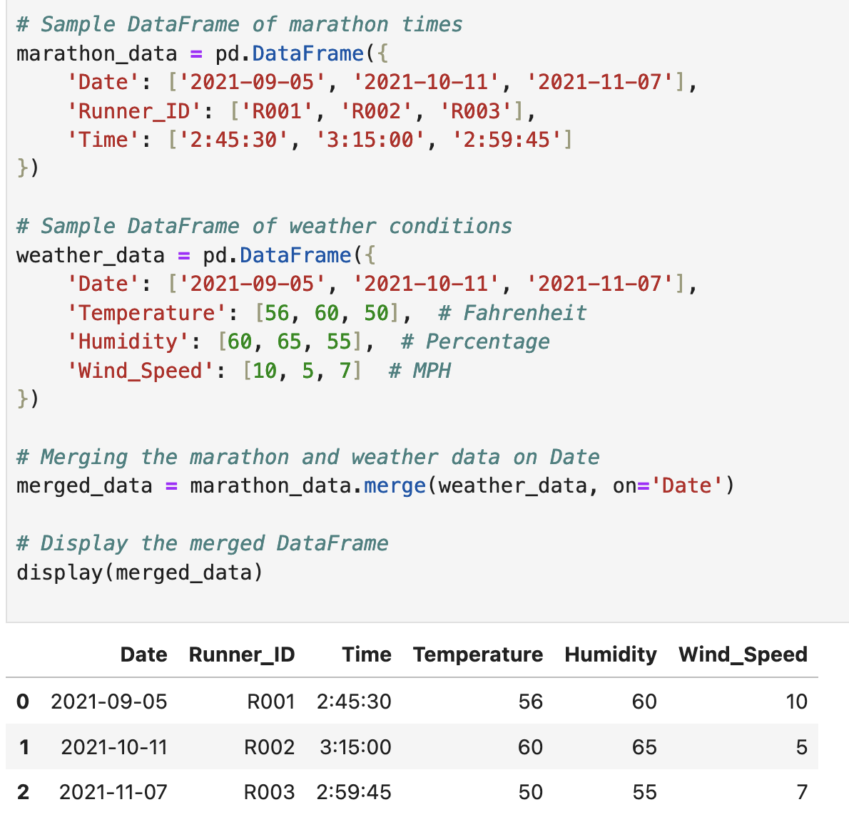

Slide 23
How to Merge Datasets in Pandas
Identify Key Columns:
Determine which column(s) both datasets share, often used as identifiers.
Prepare DataFrames
Ensure the key columns have matching data types and no missing values.
Use pd.merge()
Merge the DataFrames using the shared key column.
Set Parameters
Specify on='key_column' to define which column to merge on.
merged_data = marathon_data.merge(weather_data, on='Date')

Slide 24

Types of merges (database joins)
https://learnsql.com/blog/learn-and-practice-sql-joins/learn-and-practice-sql-joins.webp

Slide 25
Types of Joins in Pandas
INNER: merges only rows that have matching values in both DataFrames
merged = df1.merge(df2, on='Key', how='inner')
LEFT: includes all rows from the left DF and matched rows from right DF
merged = df1.merge(df2, on='Key', how='left')
RIGHT: includes all rows from right DF and matched rows from left DF
merged = df1.merge(df2, on='Key', how='right')
OUTER: Combines all rows from both DFs: Fills in NaN when no match
merged = df1.merge(df2, on='Key', how='outer')
Note: NaN values are filled in where there are no matches for left, right, and outer joins!!!

Slide 26
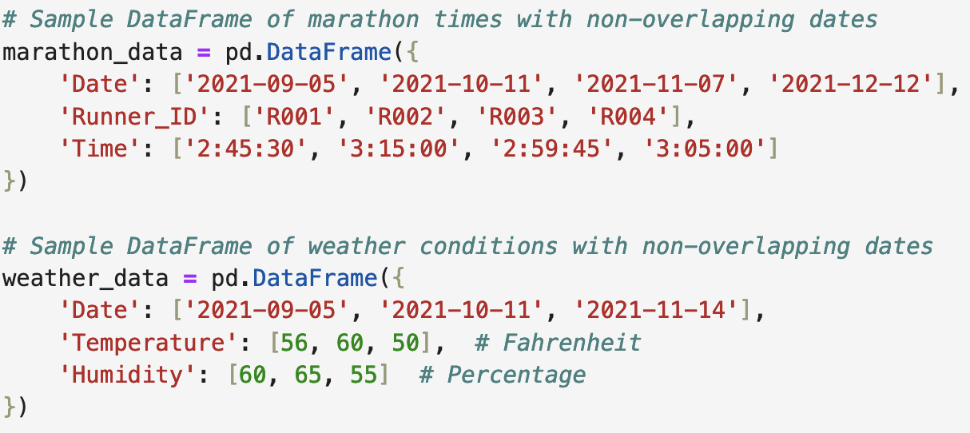
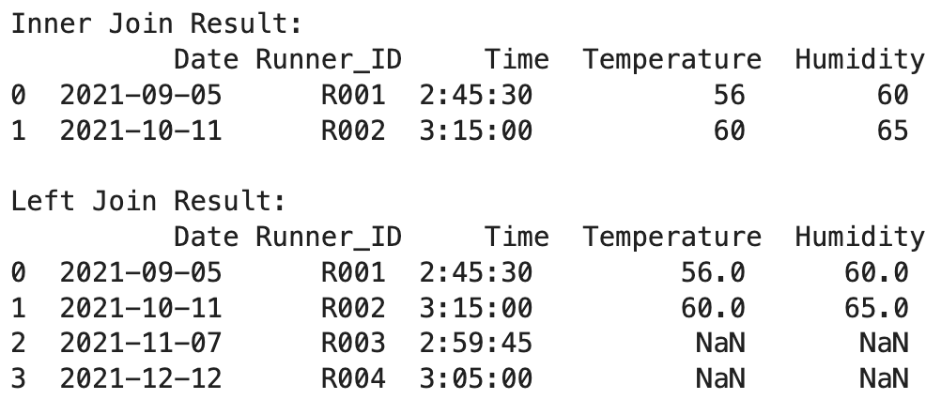
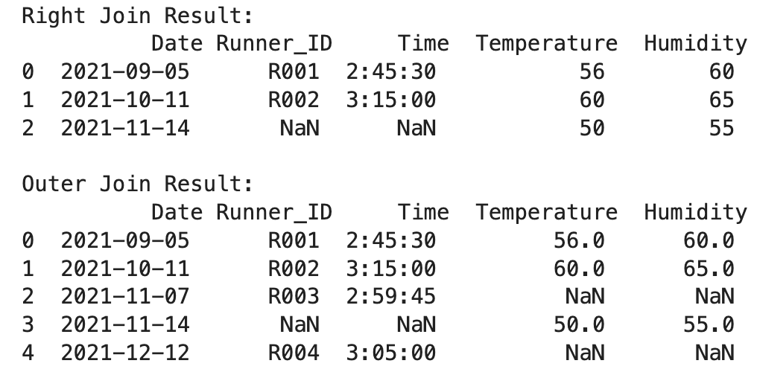

Slide 27
Key Concepts for Merging in Pandas
Data Types: Ensure key columns have the same data type.
df1['Key'] = df1['Key'].astype(str)
df2['Key'] = df2['Key'].astype(str)
Duplicate Keys: Check for duplicates in key cols before merging.
df1.drop_duplicates(subset='Key', inplace=True)
Duplicate Column Names: When column names overlap, Pandas adds suffixes (_x and _y) to differentiate.
df1 = df1.merge(df2, on='Key', inplace=True, # nope, doesn't work!
suffixes=('_left', '_right'))
Merge Order: DF order affects output, esp. in left and right joins.

Slide 28
Update, Insert, and Delete

Slide 29
Inserting or Deleting a Series
Insert a Column: Use .insert() to add a new column at a location
df.insert(loc=1, column='new_column', value=my_series)
Insert a Row: Use .concat() to append a new row at the end
df = pd.concat([df, new_row], ignore_index=True)
Delete a Column: Use .drop() with "columns=" to drop a column
df.drop(columns='column_name', inplace=True)
Delete a Row: Use .drop() with the index to remove a row
df.drop(index=0, inplace=True) # Delete first row

Slide 30
Updating values by position
Assignment: Change specific items, columns, or ranges in DF
df['column_name'] = new_value # Update entire column
df.loc[2, 'column_name'] = new_value # Update specific item
df.loc[0:2, 'column_name'] = new_value # Update a range

Slide 31
Conditional Replacement
Using np.where():
df['new_col'] = np.where(df['col'] > 10, 0, df['col'])
final_df = curved_df.where(curved_df > df, df) # spongebob
Using .mask():
df['col'] = df['col'].mask(df['col'] < 10, 0)
Using .apply():
df['col'] = df['col'].apply(lambda x: 0 if x < 10 else x)

Slide 32
More Conditional Replacement Methods
Using .replace() with a Dictionary:
df['col'].replace({10: 0}, inplace=True)
Using .fillna():
df['col'].fillna(0, inplace=True)
Note: .where() is current best practice for large datasets

Slide 33
Pandas Project
Due in about one week
Part 1 practice problems, cheatsheet available soon

